Slide 1
Team 4
Chung Kok Hui
Desmond Chiam
Jason Lee
Andrew Yap
Ang Bohan
Edna Wong
SUPERSTORE
DATA ANALYSIS

Slide 2
Agenda
Roles
Data Analyst Andrew Yap
Ang Bohan
Edna Wong
Data Scientist Chung Kok Hui
Desmond Chiam
Jason Lee
Data Engineer Chung Kok Hui
DA
DS
DS
DE
Data Exploration & Preparation
Deploy Data Models
DA
DS
DA
DS
DE
Business Understanding
Summary & Reflection
Data Representation & Transformation
DA
DS
DE
Validate Data Models
Data Visualization & Presentation
Train Data Models
DA
DS

Slide 3
Introduction
Project Objectives
Learn and understand the use of data science methodology in exploration and analysis of the sales and returns data to build a predictive data model to predict the return orders.
Tools utilised
Mural for collaboration and Enterprise Design Thinking process
IBM Watson Studio for data analytics –Data Refinery –Data Visualization –Auto AI –Machine Learning –Cloud Object Storage
Excel
Tableau
Jupyter Notebook
PyCharm
Git
Heroku
Python
Libraries:
– Pandas – Seaborn – Matplotlib – Numpy – scikit-learn – Imblearn – Plotly – Jinja
– Flask

Slide 4
Introduction
Business Understanding
Mural
Data Exploration & Preparation
Excel & IBM Watson’s Data Refinery
Data Representation & Transformation
Data Visualization & Presentation
IBM Watson’s Data Visualization, Tableau
Train Data Models
IBM Watson’s Auto AI, Machine Learning, Python
Validate Data Models
Deploy Data Models
IBM Watson’s Studio, Python
Summary & Reflection

Slide 5
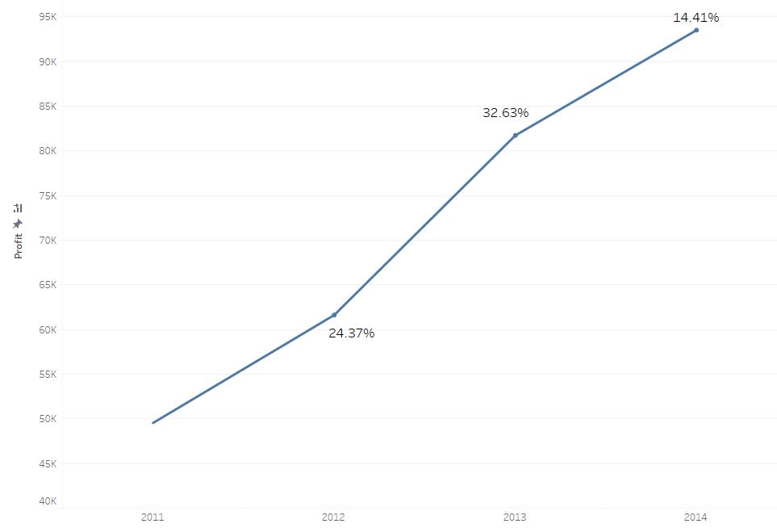
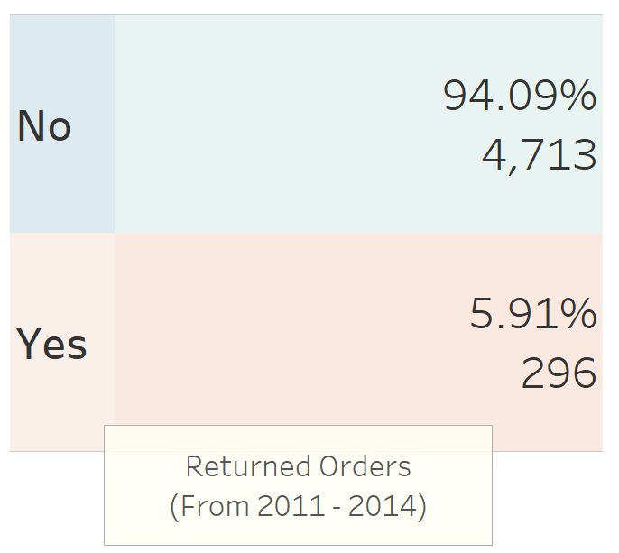
Introduction
There is an upward trend of Year Over Year (YOY) growth from 2011 to 2014.
However, this is not the true profit as the data presented include the orders returned by Customers.
14.41%
90k
32.63%
80k
70k
Profit
60k
24.37%
50k
40k
2012
2013
2014
2011

Slide 6
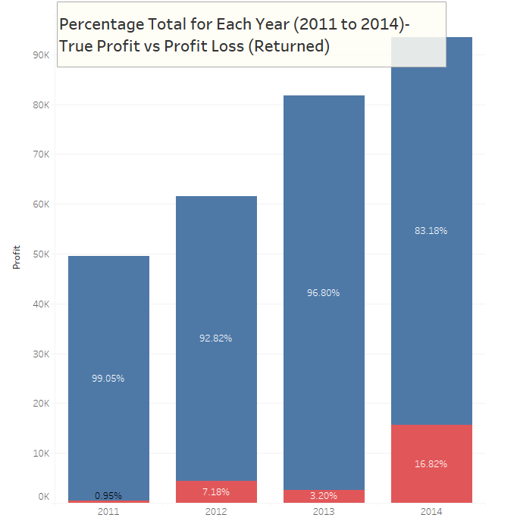
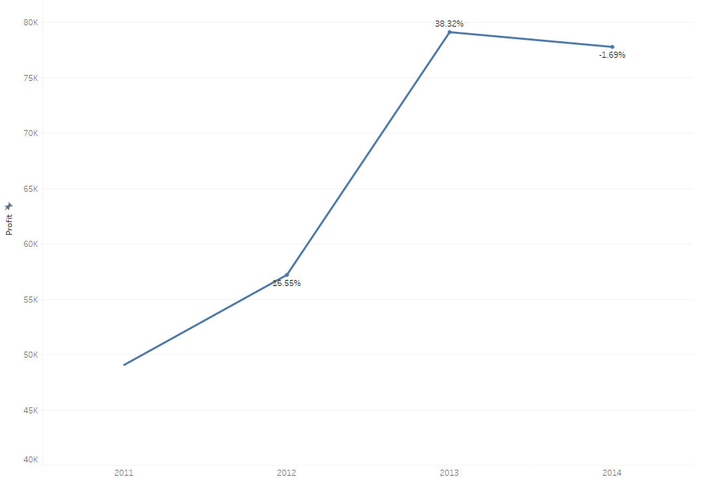
Introduction
Nearly 17% profit lost due to return policy in 2014
Profit Loss of 1.69%(YOY) in 2014
90k
38.32%
80k
80k
-1.69%
70k
70k
60k
83.18%
Profit
50k
Profit
96.80%
60k
40k
92.82%
16.55%
30k
99.05%
50k
20k
10k
16.82%
7.18%
3.20%
40k
2011
2012
2013
2014
2011
2012
2013
2014

Slide 7
Business Understanding
Planning Analytics
What is the business problem?
Andrew
The erosion of profit caused by the return orders
What is the business opportunity?
Identify the factors for return orders and take appropriate action to reduce/eliminate them to improve our sales and profit

Slide 8

Planning Analytics
How Might We Identify Potential Return Orders To Mitigate Profit Loss Due to Return Policy.

Slide 9
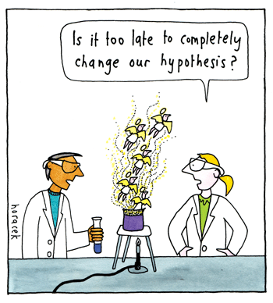
Hypothesis
Descriptive Analytics
Type of Sub-Category Returned (Return orders due to type of sub-category products)
Price (Sales) of the Product (Return orders due to the sales/price of the product)
Shipment Duration of the Product (Return orders due to shipment duration)

Slide 10
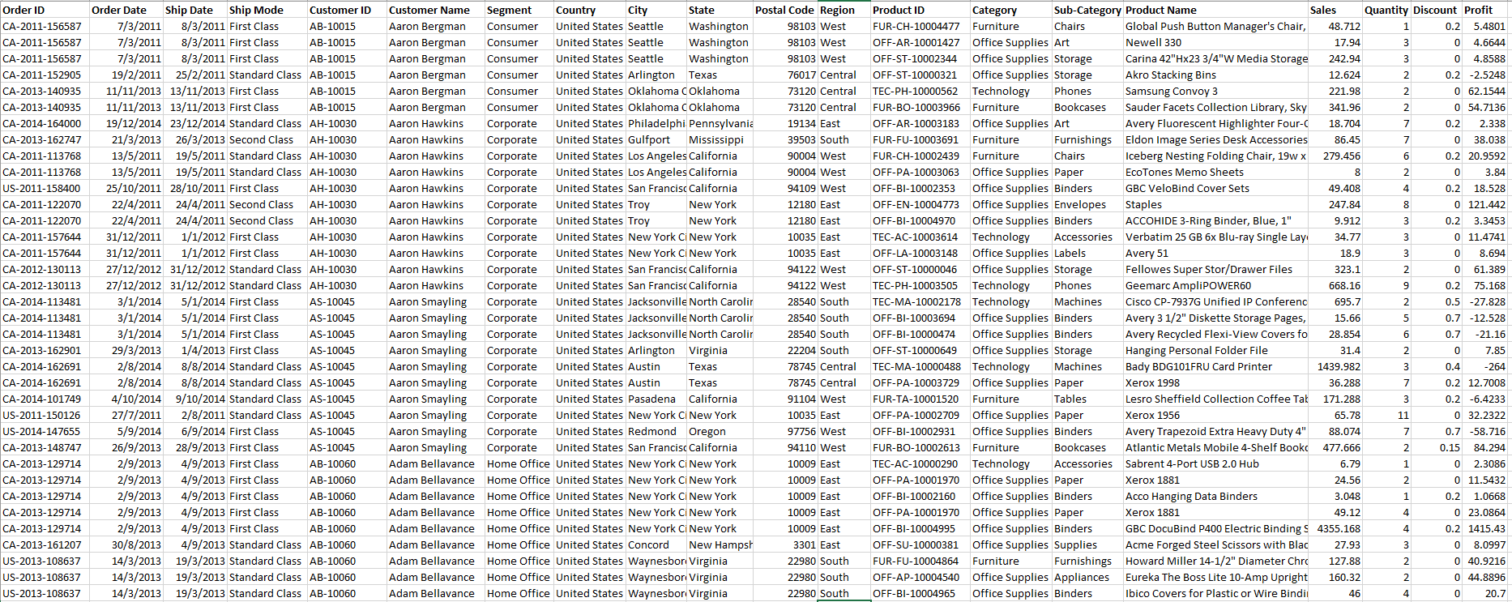
Data Exploration
Descriptive Analytics
Andrew
The data was derived from Kaggle; depicting a superstore’s business data with 9995 rows and 22 columns
Dataset Description
Contains fields: Sales; Customer details; Ship date; Sale date, Profit, Returned etc

Slide 11
Metadata
Descriptive Analytics
Andrew
Columns | Descriptor | Data Type
Row ID | Rows description | Quantitative
Order ID | Order number | Discrete
Order Date | Date of order | Quantitative/Ordinal
Ship Date | Shipping received date | Quantitative/Ordinal
Ship Mode | Transport medium and mode | Nominal
Customer ID | Customer Identification | Ordinal
Customer Name | Name of Customer | Nominal
Segment | Corporate/Home Office/Consumer | Nominal
Country | USA | Nominal
City | Cities in USA | Nominal

Slide 12
Metadata
Descriptive Analytics
Andrew
Columns | Descriptor | Data Type
State | States belonging to USA | Nominal
Postal Code | Identifier of city/state | Ordinal
Region | Four corners of USA | Nominal
Product ID | Product Identifier | Ordinal
Category | Type of Product | Nominal
Sub-Category | More detail of the type of product | Nominal
Product Name | Item descriptor | Nominal
Sales | Amount in dollars | Quantitative (Continuous)
Quantity | Amount of items | Quantitative (Continuous)
Discount | Amount in percentage | Quantitative (Continuous)
Profit | Amount of profit in USD | Quantitative (Continuous)
Returned | Yes/No | Nominal

Slide 13
Data Preparation
Descriptive Analytics
Andrew
The data was analyzed and found that some of the data was not relevant or effective descriptors to help us prove our hypothesis.
Columns such as Row ID, Product ID, Postal Code, Country were removed from the working sample data
While the data was received in Excel format, we had to save it as CSV format for IBM Auto AI to run the data.

Slide 14
Data Representation and Transformation
Descriptive Analytics
Andrew
The data was transformed by merging the Returns to the main sheet.
Columns such as Row ID, Product ID, Postal Code, Country was deemed unnecessary for us to derive any predictions and was removed.
The columns titled Order Date, Ship Date were transformed to be in ‘Date’ format versus ‘String’ format in the original file.
A new column titled ‘Duration of shipping’ was calculated in Excel for data comparision
The ‘Returned’ column was also processed in Excel to reflect ‘1’ for Yes and ‘0’ for No from the original file.

Slide 15
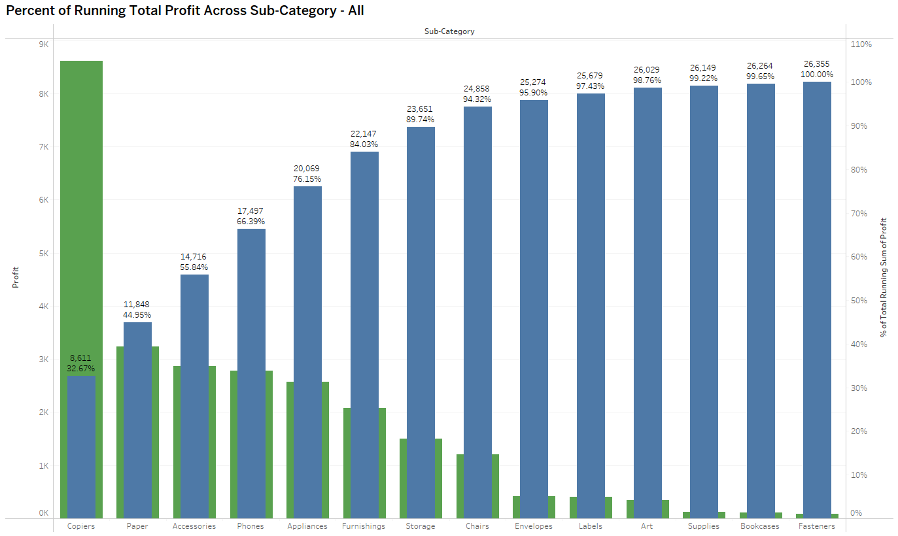
Data Visualization
Descriptive Analytics
8 Sub-Categories collectively contributed 94.32% profit (loss) of the orders returned.
Copiers
Paper
Accessories
Phones
Appliances
Furnishing
Storage
Chairs
9k
100%
8k
90%
7k
80%
6k
70%
5k
60%
% Total Running Sum of Profit
Profit
50%
4k
40%
3k
30%
2k
20%
1k
10%
Profit
Percentage
This allow us to understand which sub category for analysis.

Slide 16
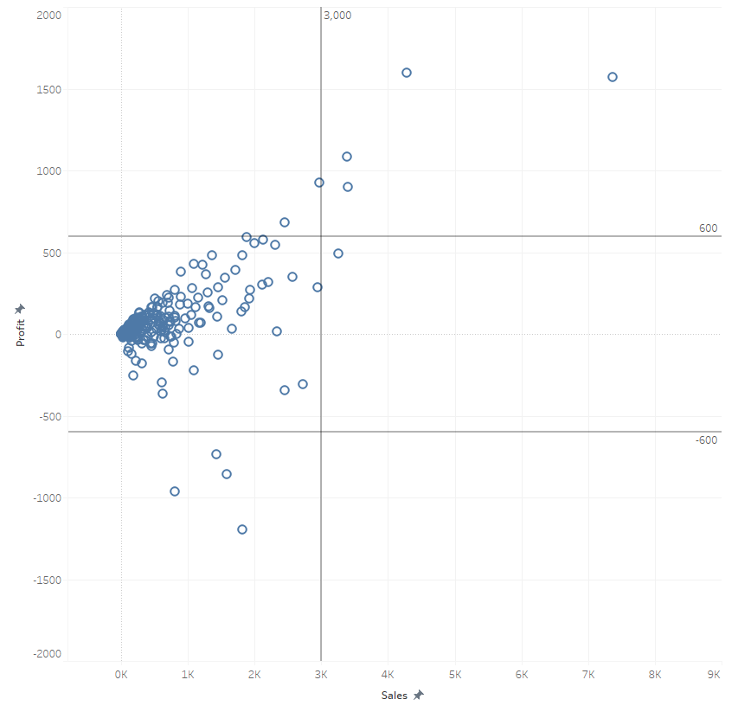
Data Visualization
Descriptive Analytics
95% of Orders Returned falls within:
1. Profit between -600 to 600.
2. Sales below 3,000.
2000
1500
1000
600
Profit
0
-600
-1000
-1500
This allow us to pick up the range of orders for training
Returned Orders
-2000
3000

Slide 17
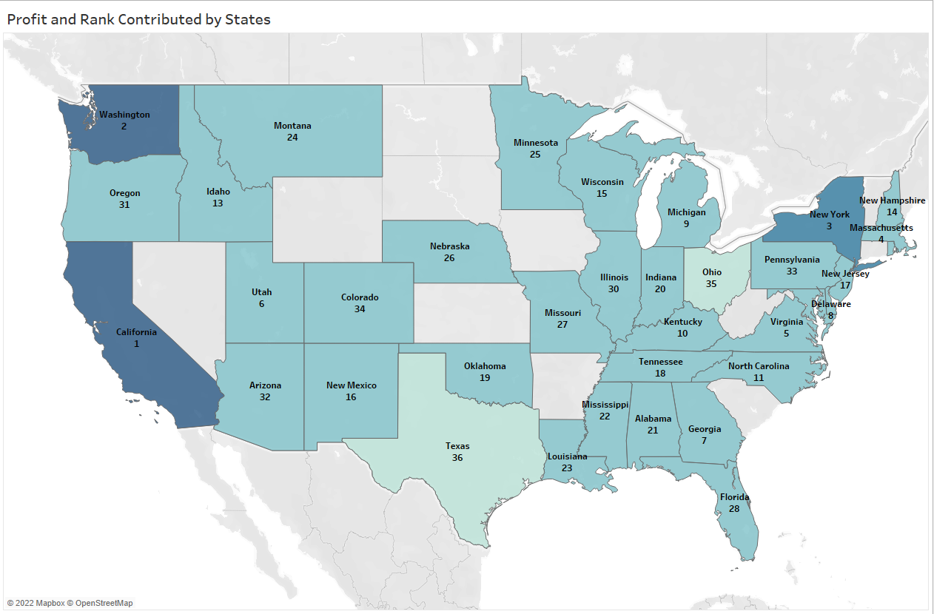
Data Visualization
Descriptive Analytics
A profile by ranking of the profit (loss) of returned orders.
California
Washington
New York
Massachusetts
Virginia
Utah
Georgia
Delaware
Lowest
Highest

Slide 18
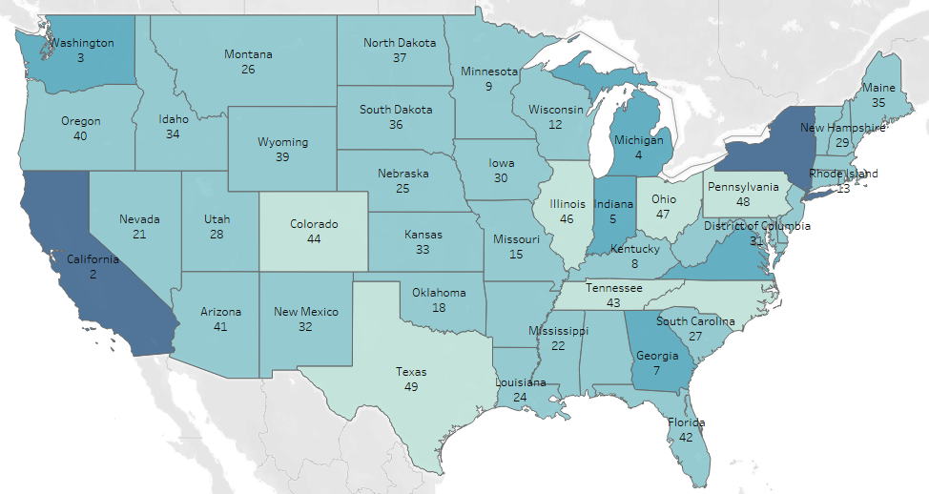
Data Visualization
Descriptive Analytics
A profile by ranking of the profit of non- returned orders.
New York
California
Washington
Michigan
Indiana
Virginia
Georgia
Kentucky
Lowest
Highest

Slide 19
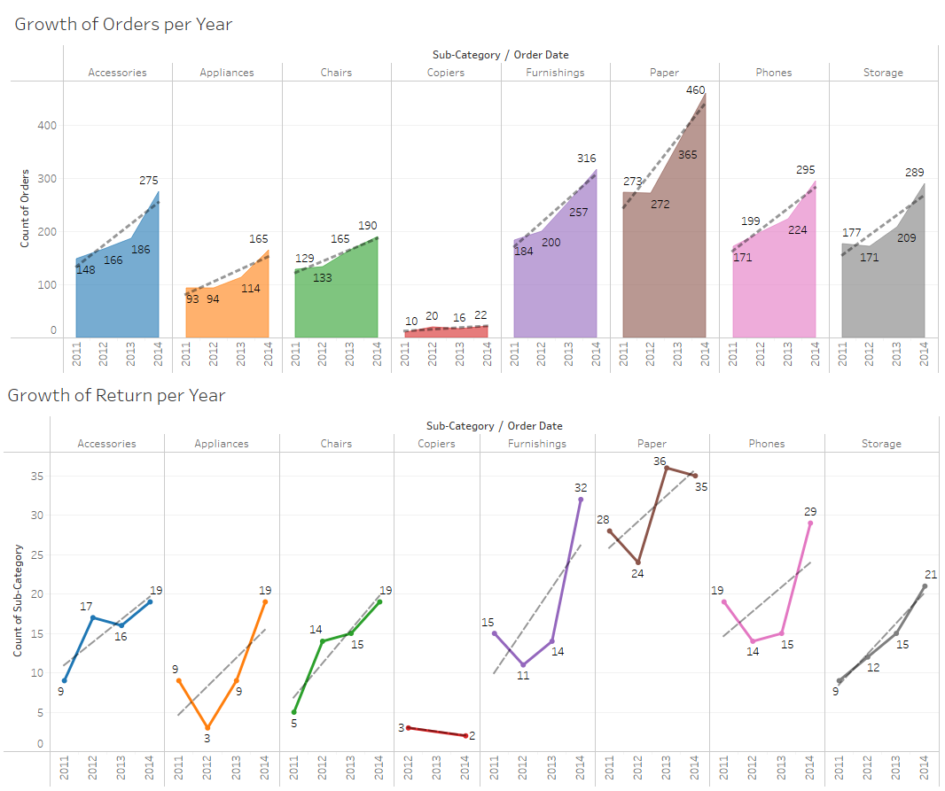
Type of Sub-Category Returned
Diagnostics
Analytics
Hypothesis Testing
Using Line Chart and Trend Line, we can observe the relationship between the number of orders for each sub-category and its return orders.
As the growth of orders in each sub-category increases over the years, there is an upward trend in return orders.

Slide 20
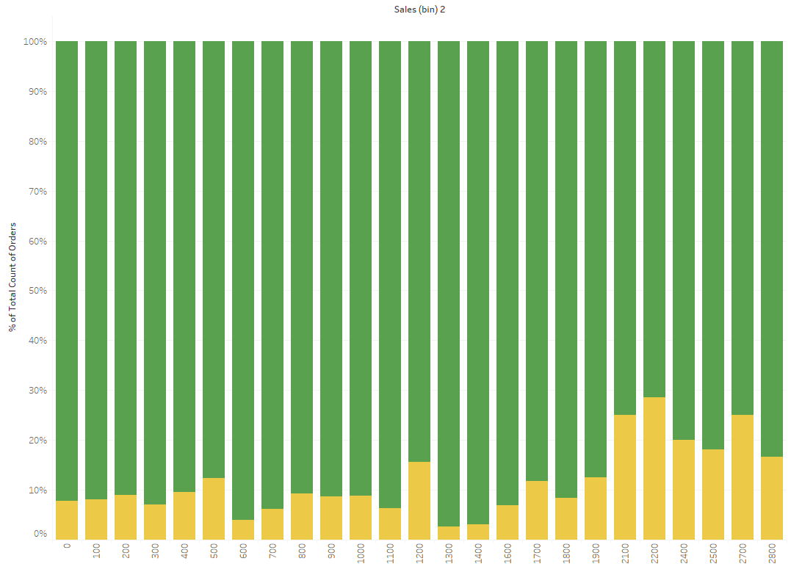
Diagnostics
Analytics
Hypothesis Testing
Sales amount per $100
Price (Sales) of the Product
Using the Stacked Bar Chart, we can observe the percentage of orders returned based on a set range of sales ($100).
We conclude that the percentage of returns for sales is higher at sales amount of ($2100 to $2800).
Percentage of Order Return
Goods Returned
No
Yes

Slide 21
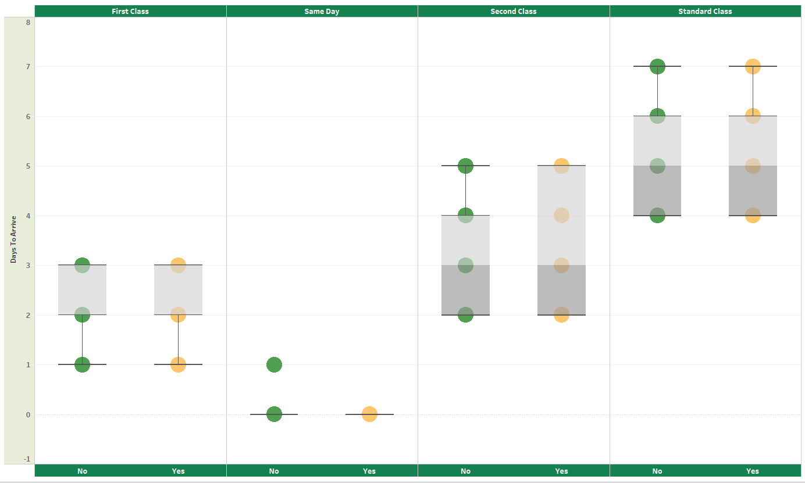
Diagnostics
Analytics
Hypothesis Testing
Shipment Duration of the Product
Using Box Plot, we can observe if the shipment duration affects the orders returned in their respective shipping method.
We conclude that it does not affect the orders returned as the duration is almost identical.
Days to Arrive
Goods Returned
No
Yes

Slide 22


Hypothesis Test Conclusion
Descriptive Analytics
Type of Sub-Category Returned (Return orders due to type of sub-category products)
Price (Sales) of the Product (Return orders due to the sales/price of the product)
Shipment Duration of the Product (Return orders due to shipment duration)

Slide 23
Predictive Analytics : Data Models
 | Tools | Features | Data Scientist / Engineer
1 | Python | *Selected | Chung Kok Hui
2 | IBM Auto AI / Machine Learning | *Selected | Jason Lee
3 | IBM Auto AI / Machine Learning | All | Desmond Chiam

Slide 24

Predictive Analytics : Train Data Models
Background Information
1. Tools Used : IBM Auto AI / Python
2. Dataset : Superstore.csv
Features : Selected/All
Output Variable : Returned
Classification : Binary
Train / Holdout Split : 90 / 10

Slide 25
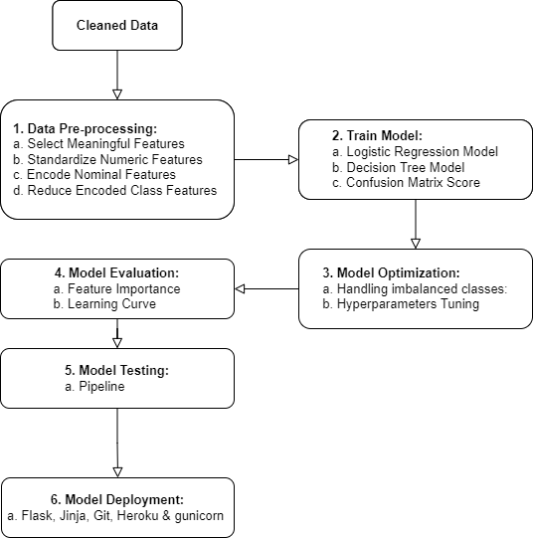
Predictive Analytics
Using Python

Slide 26







Predictive Analytics
Python Libraries,
Framework &
Integrated Development Environment

Slide 27
Data Pre-processing
Based on the findings from Descriptive and Diagnostic
Analytics, the following features are selected:
Select Meaningful Features
Features | Data Type | Pre-processing Method
State | Qualitative (Nominal) | One-hot Encoding
Sub-Category | Qualitative (Nominal)
Sales | Quantitative (Continuous) | Feature Scaling
Profit | Quantitative (Continuous)
Returned | Qualitative (Binary)
Input Variables
Output Variable

Slide 28

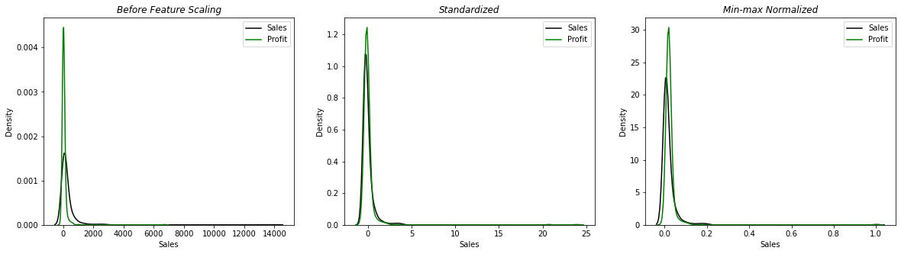
Data Pre-processing
Standardized Quantitative Features
Standardized method is selected as both profit and sales
distribution display very similar normal distribution.

Slide 29
Data Pre-processing
Encode Nominal Features
There is a need to reduce the encoded class columns to improve the performance of model.
Nominal Features | Data Type | Number of Classes | Number of Cols After One –Hot Encoding
State | Qualitative (Nominal) | 49 | 49 – 1 = 48
Sub-Category | Qualitative (Nominal) | 17 | 17 – 1 =16
Total Columns as Input Variables: |  |  | 48 + 16 +2 = 66

Slide 30
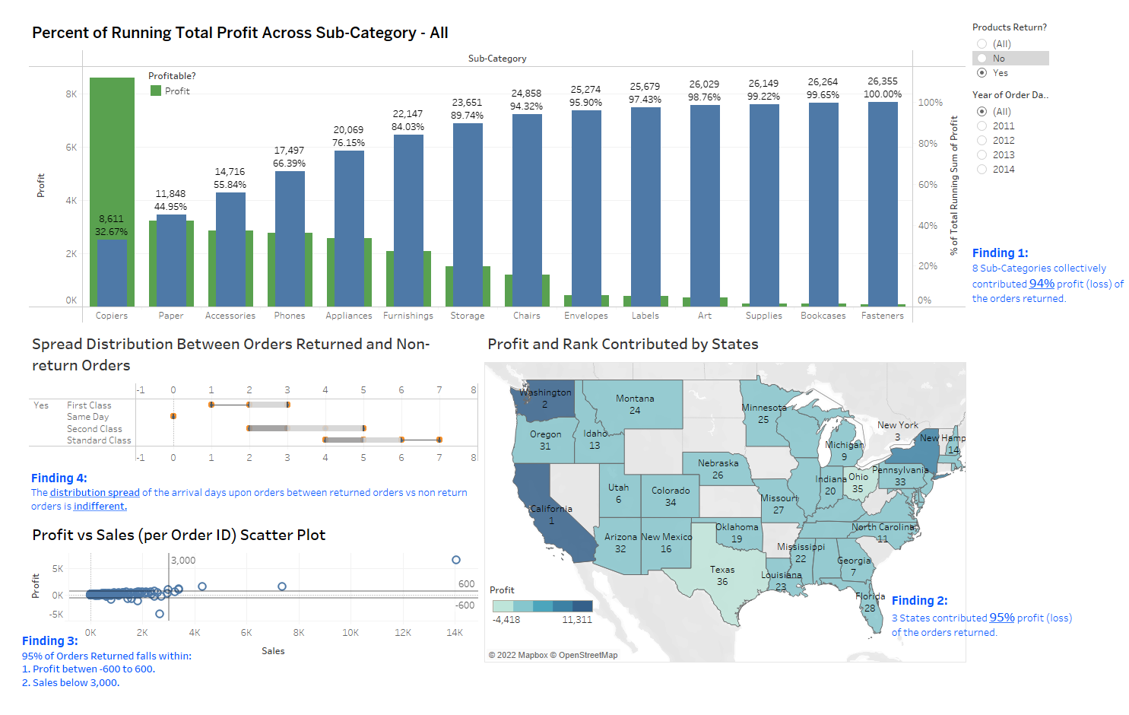
Data Pre-processing
Reduce Encoded Nominal Features
Criterion:
Using profit as the reference to find the right number
of classes from each features that best represent the
population (original) of dataset

Slide 31
Data Pre-processing
Criterion:
Using profit as the reference to find the right number
of classes from each features to represent the
population of dataset
Reduce Encoded Nominal Features
 | Returned Orders | Non-Return Orders | Num of Encoded Class Selected
Sub- Category | 8 Sub-Cat collectively contributed 94.32% of the business profit (loss) | The same 8 Sub-Cat contributed 94.34% of the business profit | 8: Paper Furnishings Storage Phones | Accessories Chairs Appliances Copiers
States | 3 states contributed ~95% of the business profit (loss) | 9 States contributed ~96% of the business profit | 9: California Washington Virginia Indiana Minnesota | New York Michigan Georgia Kentucky

Slide 32
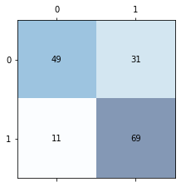
Train Model
Best performing Logistic Regression
Model on 160 Test Samples
Predicted Class
Logistic Regression
True Negative
False Positive
Actual Class
False Negative
True Positive
Performance Metric | Accuracy | Precision | Recall | f1-score
Score | 0.74 | 0.61 | 0.86 | 0.71
Hyperparameter | Regularization | C | Solver | max_iter
Value | l2 | 100 | lbfgs | 50

Slide 33
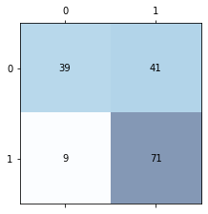
Train Model
Best performing Decision Tree
Model on 160 Test Samples
Predicted Class
Decision Tree
True Negative
False Positive
Actual Class
False Negative
True Positive
Performance Metric | Accuracy | Precision | Recall | f1-score
Score | 0.69 | 0.49 | 0.89 | 0.63
Hyperparameter | Criterion | max_depth
Value | entropy | 4

Slide 34
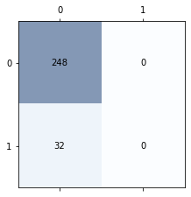
Model Optimization
Zero True Positive Values
due to imbalance of output class:
 | Output Class | Dataset
 |  | y_train | y_test
Majority Class | 0 | 2,229 | 248
Minority Class | 1 | 290 | 32
Imbalance of Output Classes
Logistic Regression
Decision Tree
Predicted Class
Predicted Class
True Negative
False Positive
True Negative
False Positive
Actual Class
Actual Class
False Negative
True Positive
False Negative
True Positive

Slide 35
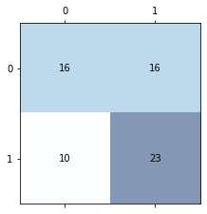
Model Optimization
 | After pre-processing | Down-sample Majority Class Only | Down-sample Majority Class And Up-sample Minority Class
Shape of dataset (rows, columns) | (2799, 17) | (644, 17) | (1600,17)
y_train (0, 1) | (2519, 290) | (290, 289) | (400,400)
y_test (0, 1) | (248, 32) | (32, 33) | (100, 100)
Metric
accuracy | 0.89 | 0.60 | 0.74
precision | 0 | 0.62 | 0.82
recall | 0 | 0.70 | 0.86
Balancing of Output Classes
Performing down-sampling and
up-sampling on majority and minority
classes respectively yields better score in accuracy and recall.
Predicted Class
Predicted Class
True Negative
False Positive
True Negative
False Positive
Actual Class
Actual Class
False Negative
True Positive
False Negative
True Positive

Slide 36
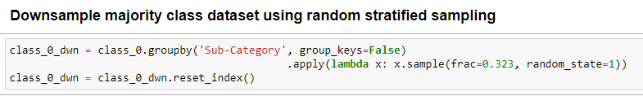
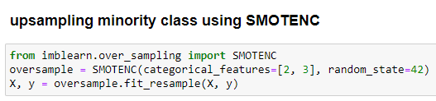
Model Optimization
Balancing of Output Classes
Reduce the majority class (0) from 2,519 rows to 800 using random sampling.
Increase the minority class (1) from 322 rows to 800 using SMOTENC

Slide 37
Model Optimization
In terms of State and Sub-Category features,
the dataset of majority class after down-sampling
still represents the population dataset
Balancing of Output Classes
State | class_0 [A] |  | class_0_dwn [B] |  | Pct Diff [B] - [A]
California | 997 | 40.25% | 323 | 40.38% | 0.12%
New York | 612 | 24.71% | 193 | 24.13% | 0.58%
Washington | 258 | 10.42% | 89 | 11.13% | 0.71%
Michigan | 149 | 6.02% | 40 | 5.00% | 1.02%
Virginia | 122 | 4.93% | 38 | 4.75% | 0.18%
Georgia | 108 | 4.36% | 37 | 4.63% | 0.26%
Indiana | 97 | 3.92% | 35 | 4.38% | 0.46%
Kentucky | 82 | 3.31% | 29 | 3.63% | 0.31%
Minnesota | 52 | 2.10% | 16 | 2.00% | 0.10%
 | 2477 | 100% | 800 | 100.00% | 0.42%
Sub-Category | class_0 [A] |  | class_0_dwn [B] |  | Pct Diff [B] - [A]
Paper | 550 | 22.20% | 178 | 22.25% | 0.05%
Furnishings | 380 | 15.34% | 123 | 15.38% | 0.03%
Storage | 374 | 15.10% | 121 | 15.13% | 0.03%
Phones | 364 | 14.70% | 118 | 14.75% | 0.05%
Accessories | 320 | 12.92% | 103 | 12.88% | 0.04%
Chairs | 264 | 10.66% | 85 | 10.63% | 0.03%
Appliances | 193 | 7.79% | 62 | 7.75% | 0.04%
Copiers | 32 | 1.29% | 10 | 1.25% | 0.04%
 | 2477 | 100% | 800 | 100.00% | 0.04%
The avg value of
sum of Pct Diff
The avg value of
sum of Pct Diff

Slide 38
Model Optimization
Likewise,
the dataset of minority class after up-sampling
still represents the population dataset
State | class_1 [A] |  | class_1_up [B] |  | Pct Diff [B] - [A]
California | 203 | 63.04% | 535 | 66.88% | 3.83%
New York | 48 | 14.91% | 119 | 14.88% | 0.03%
Washington | 43 | 13.35% | 113 | 14.13% | 0.77%
Michigan | 8 | 2.48% | 11 | 1.38% | 1.11%
Virginia | 7 | 2.17% | 7 | 0.88% | 1.30%
Georgia | 5 | 1.55% | 4 | 0.50% | 1.05%
Indiana | 3 | 0.93% | 6 | 0.75% | 0.18%
Kentucky | 3 | 0.93% | 3 | 0.38% | 0.56%
Minnesota | 2 | 0.62% | 2 | 0.25% | 0.37%
 | 322 | 100.00% | 800 | 100.00% | 1.02%
Sub-Category | class_1 [A] |  | class_1_up [B] |  | Pct Diff [B] - [A]
Paper | 87 | 27.02% | 209 | 26.13% | 0.89%
Furnishings | 53 | 16.46% | 125 | 15.63% | 0.83%
Storage | 45 | 13.98% | 123 | 15.38% | 1.40%
Phones | 41 | 12.73% | 85 | 10.63% | 2.11%
Accessories | 35 | 10.87% | 90 | 11.25% | 0.38%
Chairs | 31 | 9.63% | 104 | 13.00% | 3.37%
Appliances | 25 | 7.76% | 55 | 6.88% | 0.89%
Copiers | 5 | 1.55% | 9 | 1.13% | 0.43%
 | 322 | 100% | 800 | 100% | 1.29%
Balancing of Output Classes
The avg value of
sum of Pct Diff
The avg value of
sum of Pct Diff

Slide 39
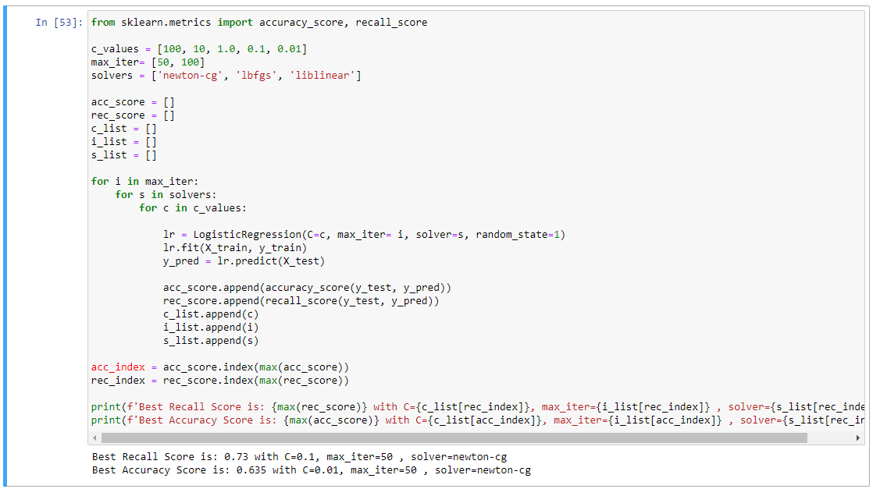
Model Optimization
Initial stage of Tuning Hyperparameters:
Tuning Hyperparameters
List out the hyperparameters for the model
2. Create an empty list to store the metrics
and its corresponding hyperparameters
3. Run 3 For loops to produce the result of
all hyperparameters combinations
The tuning was not
done using training set
4. Print the best metric score with its
corresponding hyperparameters

Slide 40
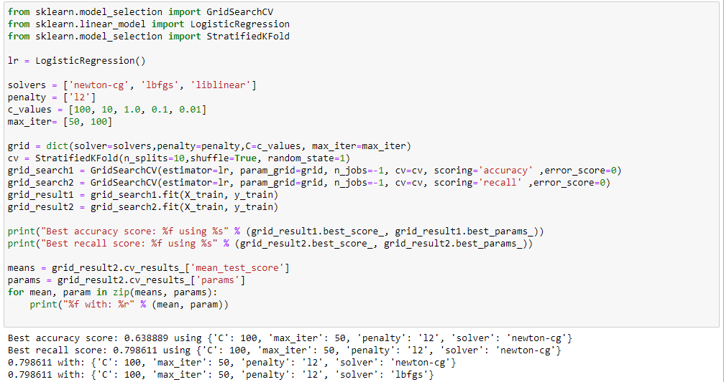
Model Optimization
Tuning Hyperparameters
Using GridSearchCV
List out the combination of each hyperparameter for the model.
2a. Create an object from GridSearchCV class with all the necessary key word arguments.
2b. Train the model with all the combination hyperparameters listed using training set.
3. Print metric score (recall) with all combination of corresponding
hyperparameters.
The combination with
best accuracy (0.64) and recall (0.80)
for the model is:
C = 100, max_iter = 50, solver = lbfgs

Slide 41
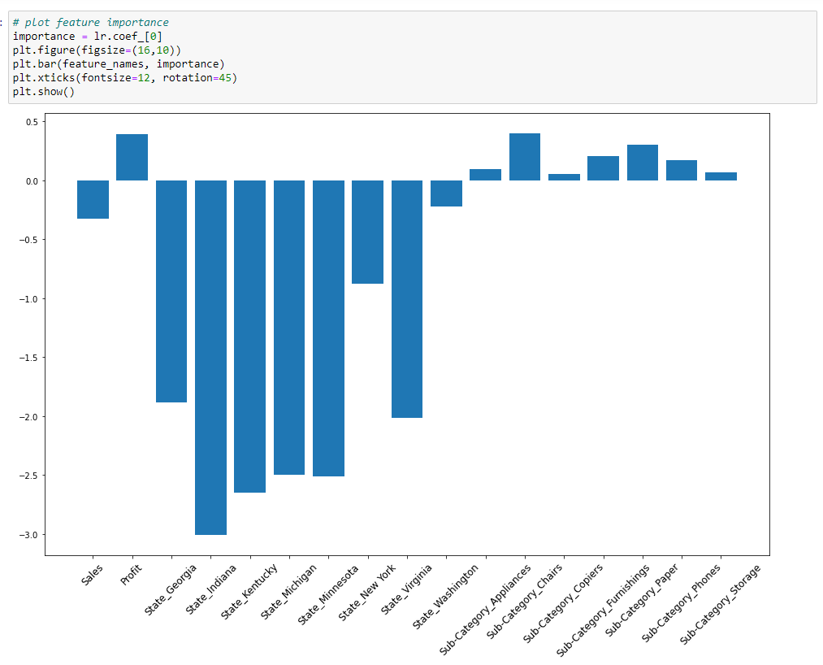
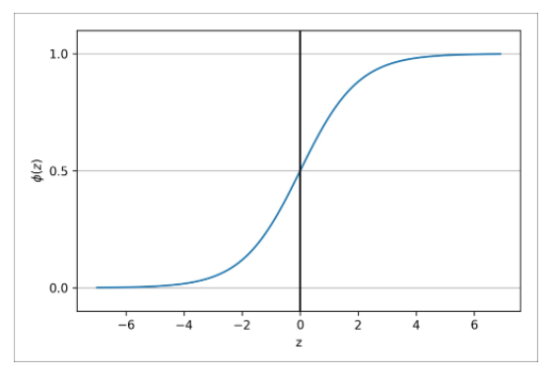
Model Evaluation
Generally:
The State has a huge influence on the probability that orders are less likely to be returned (no return orders).
Sales has a weak effect on the probability that orders are less likely to be returned (no return orders).
Profit and Sub-Category have small impact on the probability that orders are more likely to be returned(returned orders)
Is my ML model aligned
with the team’s hypothesis?
Sales & Profit
Sub-Category
Φ(z) = sigmoid function
State
z = Sum of Features with its weight (coefficient)

Slide 42


Hypothesis Testing Conclusion
Descriptive Analytics
Type of Sub-Category Returned (Return orders due to type of sub-category products)
Price (Sales) of the Product (Return orders due to the sales/price of the product)
Shipment Duration of the Product (Return orders due to shipment duration)

Slide 43
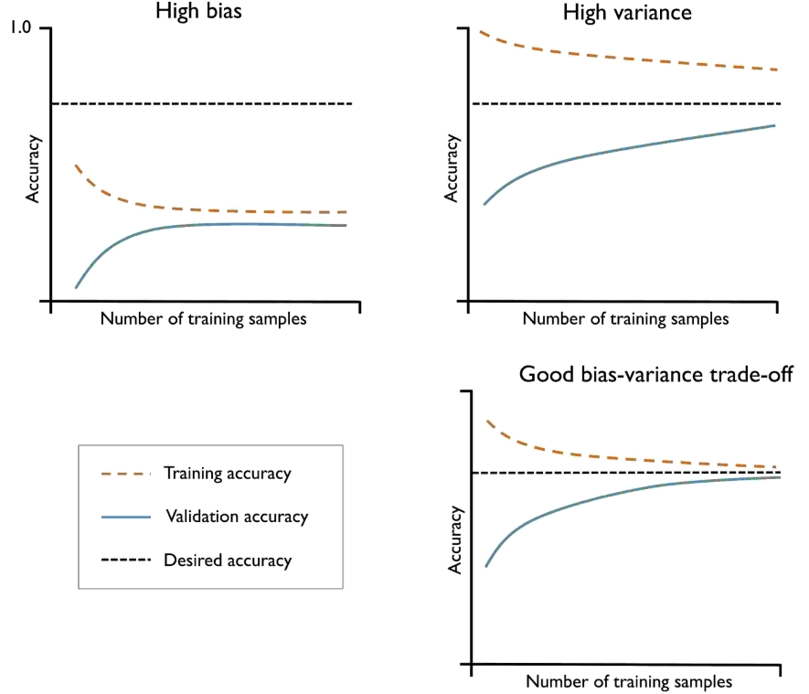
Model Evaluation
Learning Curve

Slide 44
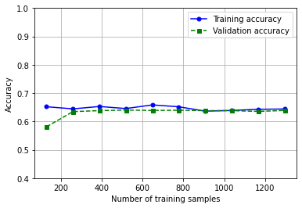
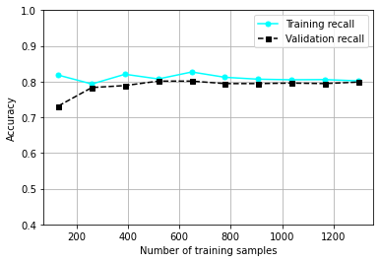
Model Evaluation
Model is high bias, low variance
Variance converges when training set is more than 100
Model will not improve with more than 200 training rows
Performance on the unseen data (test set) is better than training set.
Learning Curve

Slide 45
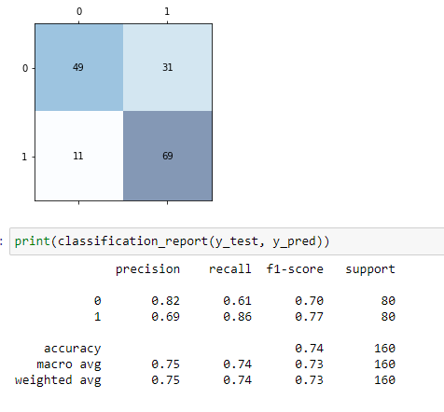
Model Evaluation
Performance on the unseen data (test set) is better than training set.
Learning Curve
recall :0.80
accuracy :0.64

Slide 46
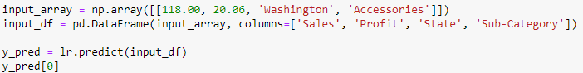
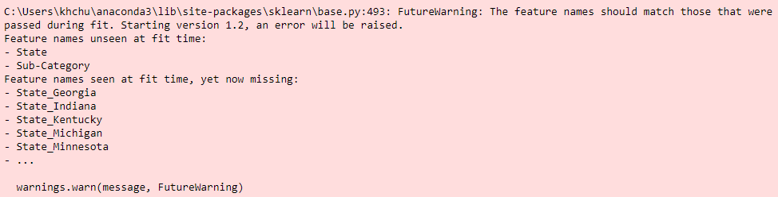
Model Testing
Transforming my single-entry input from array to pandas dataframe
2a. Predict the outcome of my single-entry
using the trained model
2b. Show the result of the prediction
Not User Friendly
The trained model requires pre-processed values as input.
i.e:
Scaled profit & sales,
State_Kentucky,
Sub-Category_Paper

Slide 47

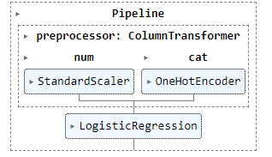
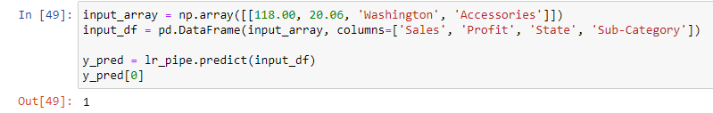
Model Testing
With the pipeline capabilities, the functions of every model
and pre-processor can be used using the original value
Streamline workflow
with pipeline
Single Input
Cleaned
Dataset
Perform any transformation listed by user
Train Model
LogisticRegression.predict
Prediction Outcome

Slide 48







Model Deployment
Jinja, Flask, Git & Heroku
MVP
Model Deployment
git commit
git push
Deploy project to Heroku repository and setup a server with gunicorn
Create webpage using
python & html files (project)
Store project in local repository using git

Slide 49
Predictive Analytics : Train Data Models
During AutoAI training, the data set is split into a training part and a hold-out part.
The training/hold-out split ratio is 90/10.
2. The training part is used by the AutoAI training stages to generate the AutoAI model pipelines and cross-validation scores used to rank them.
3. After AutoAI training, the hold-out part is used for the resulting pipeline model evaluation and computation of performance information such as ROC curves and confusion matrices, shown in the leaderboard.

Slide 50
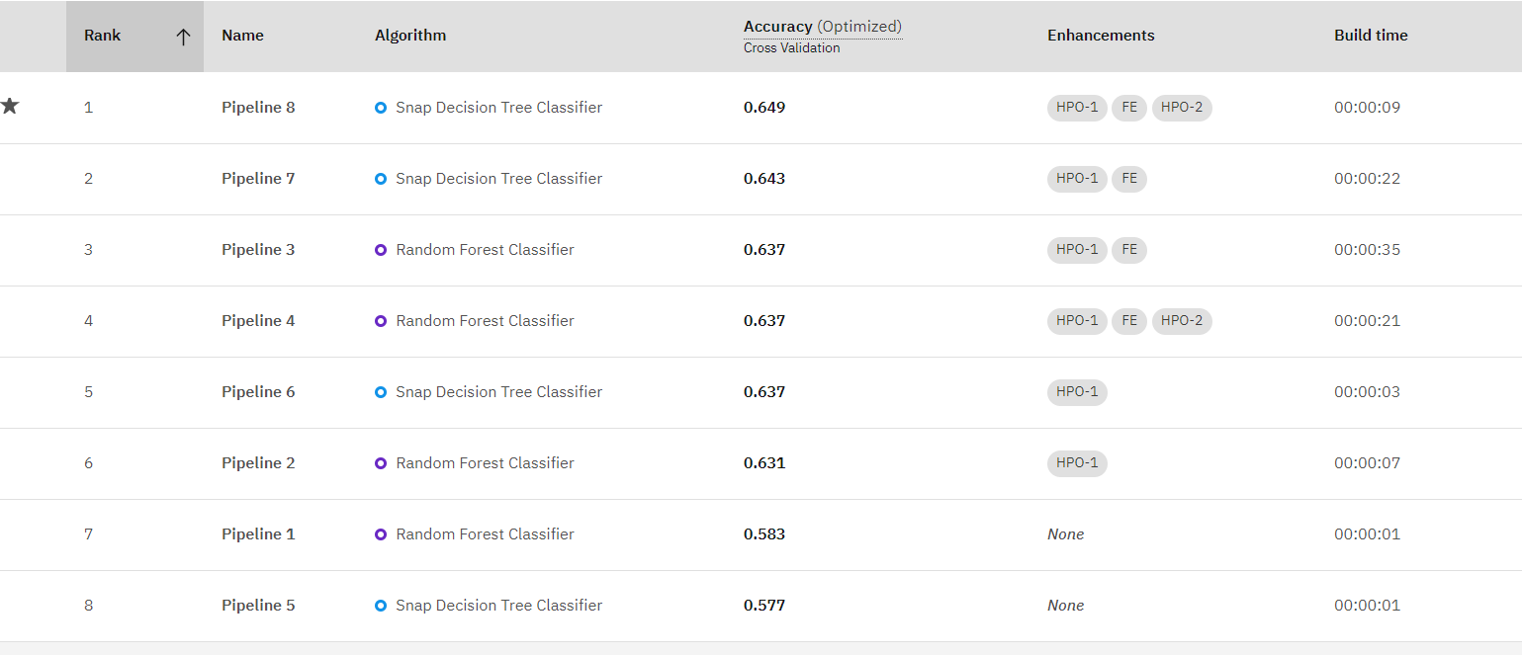
Predictive Analytics : Train Data Models
1. The data (Selected Features) were fed into IBM's Auto AI using Returned as the prediction column to predict returned sales.
Pipeline 8 with a Snap Decision Tree Classifier algorithm has the highest rank of 64.9% ROC AUC (Optimized).

Slide 51
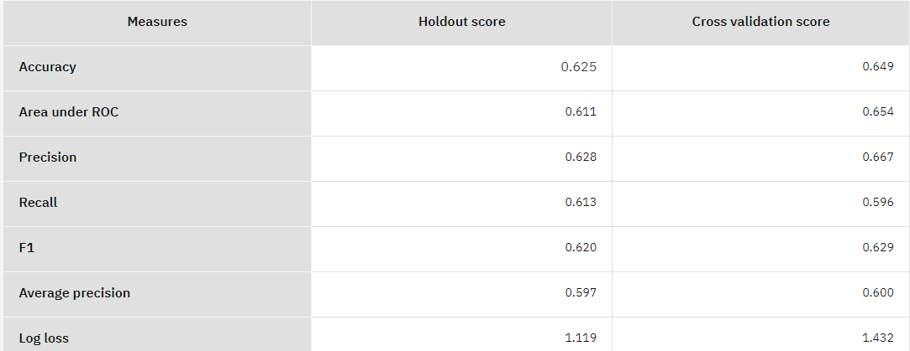
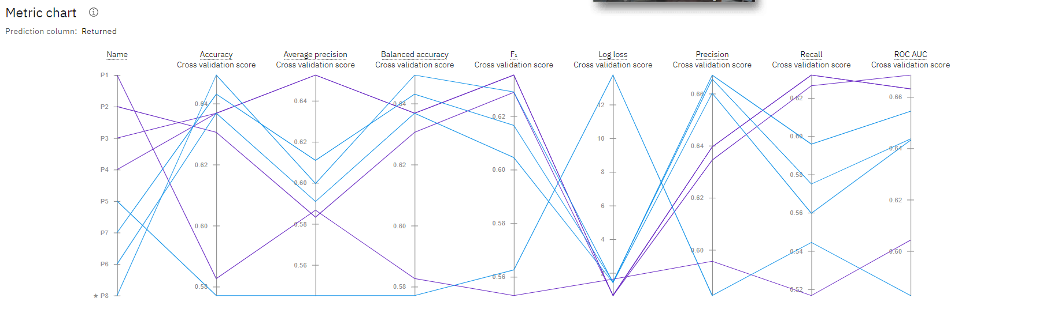
Predictive Analytics : Train Data Models
Pipeline 8
Metric Chart for the 8 generated Pipelines
Comparing all the ranked pipelines on the Metric Chart and the model based on ROC AUC (Optimized),
Pipeline 8 has the most of the highest predicted scores for the returned sales (Returned).
4. For this ‘Selected Features’ predictive data modeling, Pipeline 8 (Snap Tree Decision Classifier) is chosen for deployment.

Slide 52
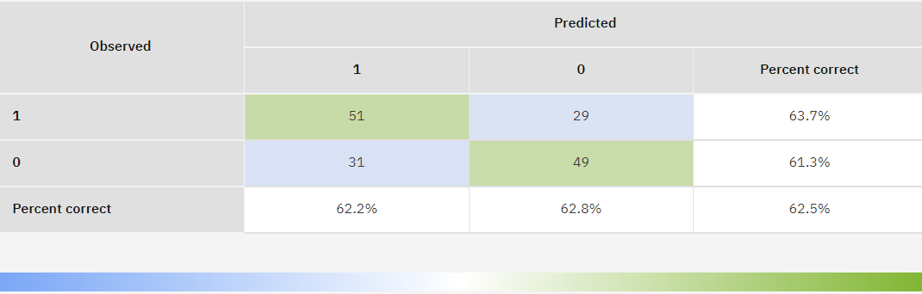
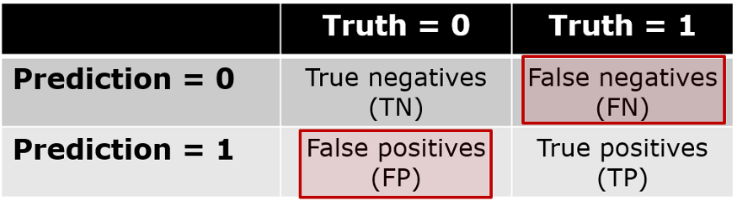
Predictive Analytics : Validate Data Models
Why is confusion matrix called confusion matrix?
The name stems from the fact that it makes it easy to see whether the system is confusing two classes (i.e. commonly mislabeling one as another).
Notes:
Confusion Matrix is a useful machine learning method which allows you to measure Recall, Precision, Accuracy, and AUC-ROC curve (specificity).
A Confusion matrix is an N x N matrix used for evaluating the performance of a classification model, where N is the number of target classes.
The matrix compares the actual target values with those predicted by the machine learning model.

Slide 53
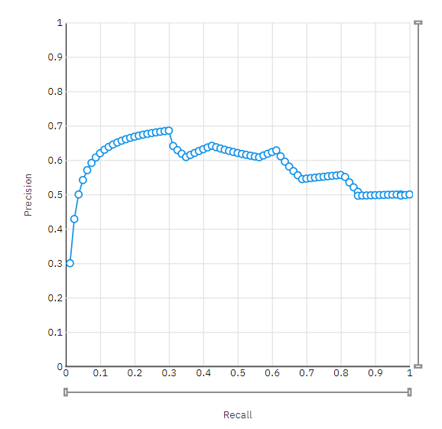
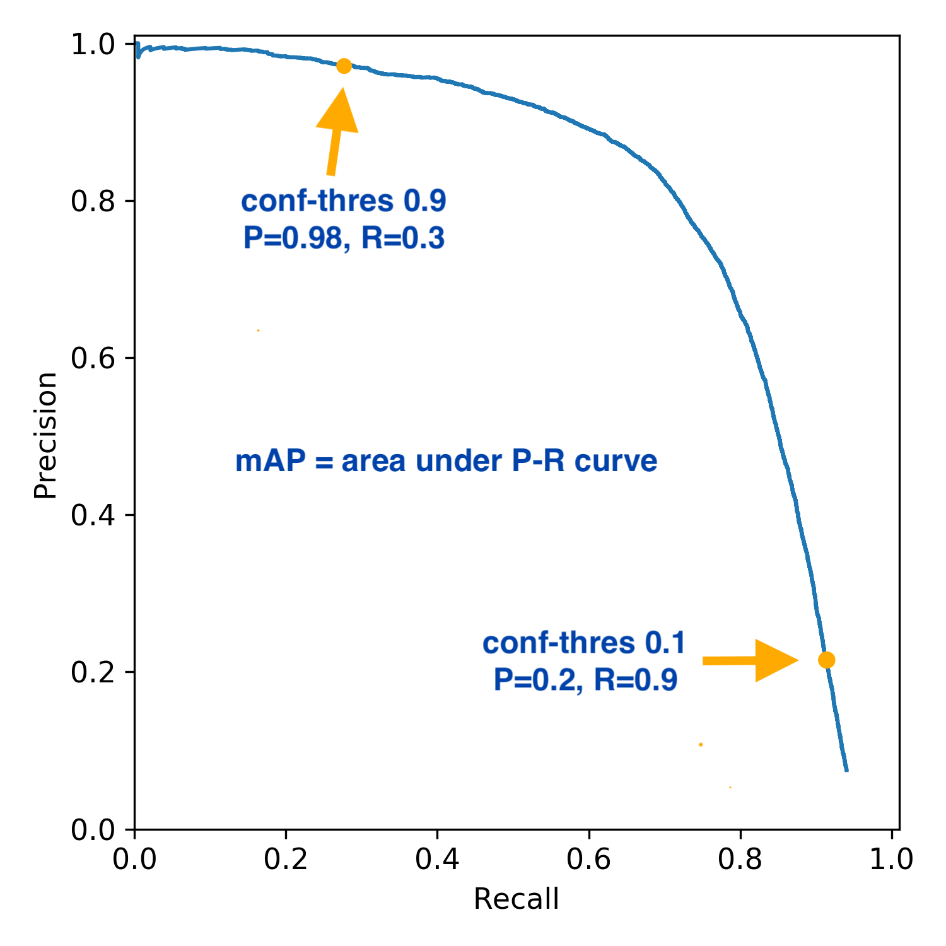
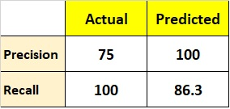
Predictive Analytics : Validate Data Models
Model Evaluation Measure (Holdout Score)
Precision 62.8%
Recall 61.3%
The precision-recall curve shows the tradeoff between precision and recall for different threshold.
A high area under the curve represents both high recall and high precision, where
high precision relates to a low false positive rate, and
high recall relates to a low false negative rate.
Precision Recall curve
Precision explains – out of total predicted as positive how many are actual positive hence known as positive predictive power of model.
Recall explains – out of total actual positives how many are predicted as truly positive which is nothing but the true positive rate.

Slide 54
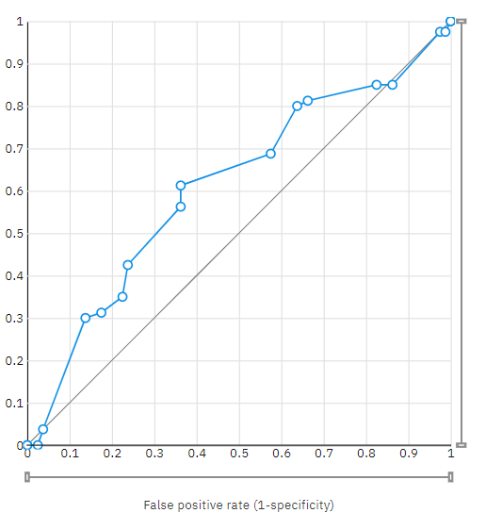
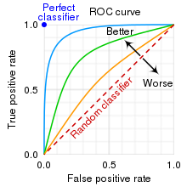
Predictive Analytics : Validate Data Models
Model Evaluation Measure (Holdout Score)
Area Under ROC 61.1%
ROC curve
The area under the ROC curve (AUC) results were considered excellent for AUC values between 0.9-1, good for AUC values between 0.8-0.9, fair for AUC values between 0.7-0.8, poor for AUC values between 0.6-0.7 and failed for AUC values between 0.5-0.6.
ROC is a probability curve and AUC represents the degree or measure of separability. It tells how much the model is capable of distinguishing between classes.
Higher the AUC, the better the model is at predicting 0 classes as 0 and 1 classes as 1.
Notes:
ROC curve (Receiver Operating Characteristic curve)
What is sensitivity and specificity example?
If 100 patients known to have a disease were tested, and 43 test positive, then the test has 43% sensitivity.
If 100 with no disease are tested and 96 return a completely negative result, then the test has 96% specificity.
Sensitivity : the ability of a test to correctly identify patients with a disease.
Specificity : the ability of a test to correctly identify people without the disease. True positive : the person has the disease and the test is positive.
Is it better to have higher specificity or sensitivity?
Likewise, high specificity — when a test does a good job of ruling out people who don't have the disease – usually means that the test has lower sensitivity (more false-negatives).

Slide 55
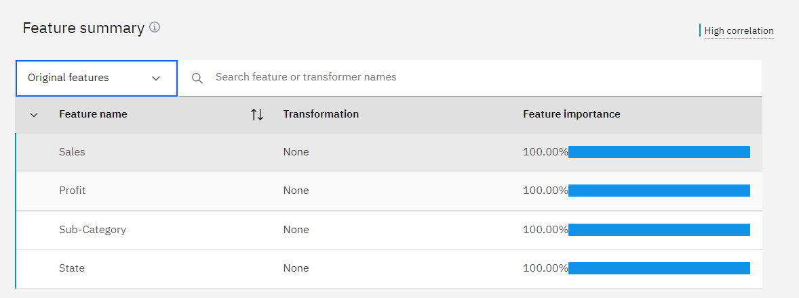
Predictive Analytics : Validate Data Models
Pipeline 8 - Selected Feature Summary has the following features: Sales, Profit, Sub-Category, State

Slide 56
Predictive Analytics
Train Data Models
Validate Data Models
Desmond Chiam
Team 4

Slide 57


Predictive Analytics
Train Data Models
Pipeline Comparison
Model Evaluation Measure
Metric Chart

Slide 58
Predictive Analytics : Train Data Models
IBM Auto AI / Machine Learning
All Features
Let IBM Auto AI to determine the high correlation features as compared to the *selected features
for predicting the column, Returned.
*Diagnostic Analytics : State, Sub-Category, Sales and Profit

Slide 59
Predictive Analytics : Train Data Models
Background Information
1. Tools Used : IBM Auto AI / Machine Learning
2. Dataset : Superstore.csv
3. Features : All
4. Prediction Column : Returned
Classification : Binary
6. Train / Holdout Split : 90 / 10

Slide 60

Predictive Analytics : Train Data Models
During AutoAI training, the data set is split into a training part and a hold-out part.
The training/hold-out split ratio is 90/10.
2. The training part is used by the AutoAI training stages to generate the AutoAI model pipelines and cross-validation scores used to rank them.
3. After AutoAI training, the hold-out part is used for the resulting pipeline model evaluation and computation of performance information such as ROC curves and confusion matrices, shown in the leaderboard.
This Photo by Unknown Author is licensed under CC BY

Slide 61
Predictive Analytics : Train Data Models
1. The data were fed into IBM's Auto AI using Returned as the prediction column to predict returned sales.
Pipeline 4 using XGB Classifier algorithm has the highest rank of 82.3% ROC AUC (Optimized).

Slide 62
Predictive Analytics : Train Data Models
Pipeline 4
Metric Chart for the 8 generated Pipelines
Comparing all the ranked pipelines on the Metric Chart and the model based on ROC AUC (Optimized),
Pipeline 4 has the most of the highest predicted scores for the column, Returned.
4. For this ‘All Features’ predictive data modeling, Pipeline 4 (XGB Classifier) is chosen for deployment.

Slide 63


Predictive Analytics
2. Validate Data Models
Confusion Matrix
Precision Recall curve
ROC curve
Feature Summary

Slide 64
Predictive Analytics : Validate Data Models
Pipeline 4
Why is confusion matrix called confusion matrix?
The name stems from the fact that it makes it easy to see whether the system is confusing two classes (i.e. commonly mislabeling one as another).

Slide 65
Predictive Analytics : Validate Data Models
Pipeline 4
Model Evaluation Measure (Holdout Score)
Precision 75.0%
Recall 86.3%
The precision-recall curve shows the tradeoff between precision and recall for different threshold.
A high area under the curve represents both high recall and high precision, where
high precision relates to a low false positive rate, and
high recall relates to a low false negative rate.
Precision Recall curve
Precision explains – out of total predicted as positive how many are actual positive hence known as positive predictive power of model.
Recall explains – out of total actual positives how many are predicted as truly positive which is nothing but the true positive rate.

Slide 66
Predictive Analytics : Validate Data Models
Pipeline 4
Model Evaluation Measure (Holdout Score)
Area Under ROC 85.9%
ROC curve
The area under the ROC curve (AUC) results were considered excellent for AUC values between 0.9-1, good for AUC values between 0.8-0.9, fair for AUC values between 0.7-0.8, poor for AUC values between 0.6-0.7 and failed for AUC values between 0.5-0.6.
ROC is a probability curve and AUC represents the degree or measure of separability. It tells how much the model is capable of distinguishing between classes.
Higher the AUC, the better the model is at predicting 0 classes as 0 and 1 classes as 1.

Slide 67
Predictive Analytics : Validate Data Models
Pipeline 4
Pipeline 4 - Feature Summary has identified Postal Code having high correlation (100%) to the predicted column, Returned, for the order returns.

Slide 68
Predictive Analytics : Validate Data Models
Feature Summary for the generated 8 pipelines
IBM Auto AI : Postal Code vs Diagnostic Analytics : State, Sub-Category, Sales and Profit
Based on the ‘All Features’, the 8 pipelines generated by IBM Auto AI rejected our hypothesis.

Slide 69
Predictive Analytics : Data Models
 | Tools | Features | Data Scientist / Engineer | Algorithm | Recall | Accuracy
1 | Python | Selected | Chung Kok Hui | Logistic Regression | 86.0% | 74.0%
2 | IBM Auto AI / Machine Learning | Selected | Jason Lee | Snap Decision Tree Classifier | 61.3% | 62.5%
3 | IBM Auto AI / Machine Learning | All | Desmond Chiam | XGB Classifier | 86.3% | 78.7%
The predicted data models by (1) Python (using Logistic Regression) and (3) IBM Auto AI/ML (using XGB Classifier) have about the same Recall and Accuracy.
But Python data model (1) validated 1of our hypothesis and while IBM data model (3) rejected them.
For our testing, we shall showcase the two data models (1) and (3).

Slide 70
Prescriptive Analytics : Deploy Data Models

Slide 71
Prescriptive Analytics : Deploy Data Models
Feature Summary has identified Postal Code having High correlation (100%) to the predicted column, Returned, for the returned sales.
For the online Test, we shall input Postal Code to predict the Returned.

Slide 72
Prescriptive Analytics : Deploy Data Models

Slide 73
Prescriptive Analytics : Deploy Data Models

Slide 74
Prescriptive Analytics : Deploy Data Models
Test Data Result
Test Data Result : Predicted 80% returned sales for 8 out of 10 records

Slide 75
Summary and Reflection
Our Python Model indicates that sales and types of sub-category products has a weak effect in predicting the outcome of return orders
The feature importance generated from AutoAI and Python suggest that geographical location has the major influence the performance of the model.
3. Our hypothesis will require more meaningful features to facilitate a better analysis and prepare a prediction data model for minimizing returns such as :
Reason for Returns
Customer Received Date

Slide 76
Demo: Testing Deployed Models
(AutoAI & Python)

